Slide 1
Form Authentication

Slide 2
Form Authentication:
As secure information is the key to efficient web programming, web application programmers always have security concerns.
Form authentication is used for internet web application. The advantage of form authentication is that users do not have to be member of a domain-based network to have access to your application. So the number of web application uses the form authentication in their web application.
There are three types of authentication in ASP.NET,
Windows authentication
Forms authentication
Passport Authentication
Form Authentication
Form Authentication is a token-based system. When users log in, they receive a token with user information that is stored in an encrypted cookie.
When a user requests an ASP.NET page via the browser, the ASP.NET verifies whether the form authentication token is available.
If it is, then runtime redirects the user to a login page and the validation process of user name and password.
If the user is successfully validated, the runtime is automatically configured with the authentication cookie that actually contains the ticket.

Slide 3
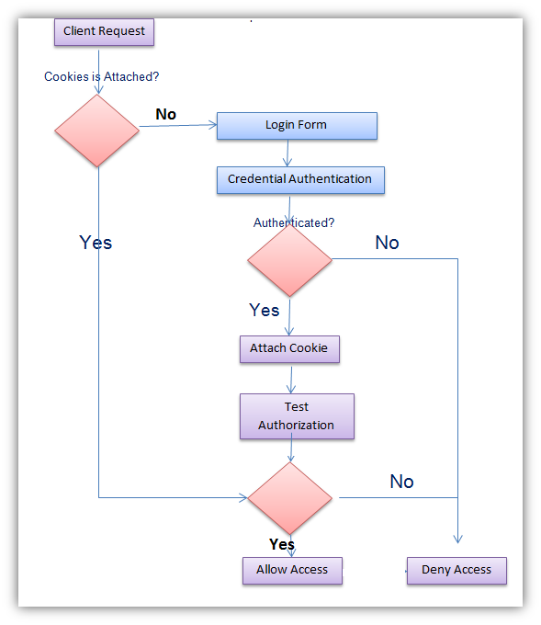
Form Authentication

Slide 4
Form Authentication proposed couple of fascinating features.
First, since form authentication is implemented entirely within ASP.NET infrastructure, so developers have full jurisdiction over authentication mechanism.
Second, this feature can be supported by all browsers because it practices standard HTML, so no platform dependency disputes occurs.
Finally, the developer himself can determine the storage medium of the crucial credentials.

Slide 5
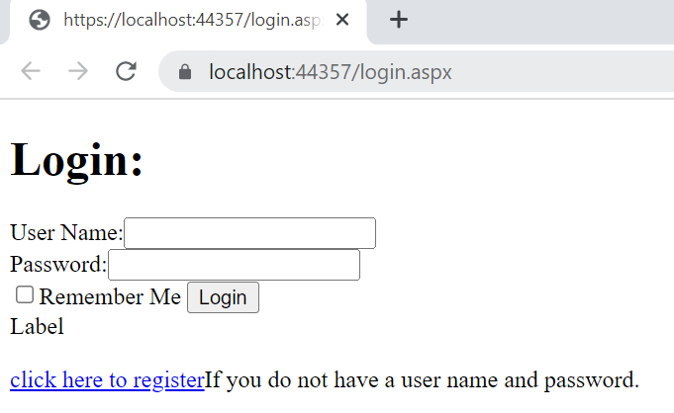
Login.aspx
<div>
<h1>Login:</h1>
User Name:<asp:TextBox ID="TextBox1" runat="server"></asp:TextBox><br />
Password:<asp:TextBox ID="TextBox2" runat="server"></asp:TextBox><br />
<asp:CheckBox ID="CheckBox1" runat="server" Text="Remember Me" />
<asp:Button ID="Button1" runat="server" Text="Login" OnClick="Button1_Click" /><br />
<asp:Label ID="Label1" runat="server" Text="Label"></asp:Label><br /><br />
<a href="register.aspx">click here to register</a>If you do not have a user name and password.
</div>

Slide 6
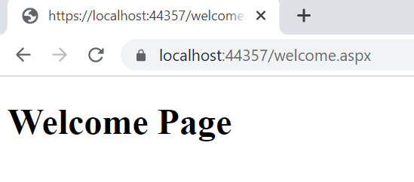
Welcome.aspx
<div>
<h1>Welcome Page</h1>
<div>

Slide 7
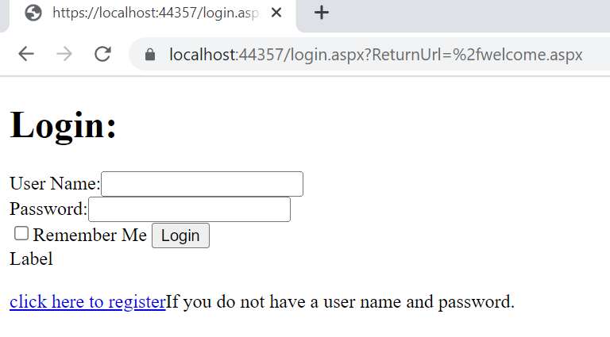
Enable Form Authentication:
Web.Config File--→Under compilation tag
<authentication mode="Forms">
<forms loginUrl="login.aspx“ defaultUrl="Welcome.aspx">
<credentials passwordFormat="Clear">
<user name="Neha" password="Neha"/>
<user name="More" password="More"/>
</credentials>
</forms>
</authentication>
<authorization>
<deny users="?"/>
</authorization>
Run: welcome.aspx

Slide 8
Login.aspx.cs
using System.Web.Security;
protected void Button1_Click(object sender, EventArgs e)
{
if(FormsAuthentication.Authenticate(TextBox1.Text ,TextBox2.Text))
{
FormsAuthentication.RedirectFromLoginPage(TextBox1.Text, false);
}
else
{
Label1.Text = "Invalid user Name and Password";
}
}

Slide 9

Copy the url , close the current browser and then use another
instance of the browser copy the same URL You will not get Welcome.aspx instead it will redirect to login.aspx.because cookies are deleted from the browser. Because we have wriiten following code:
FormsAuthentication.RedirectFromLoginPage(TextBox1.Text, false);
FormsAuthentication.RedirectFromLoginPage(TextBox1.Text, CheckBox1.Checked);
Cookie remains persists.

Slide 10
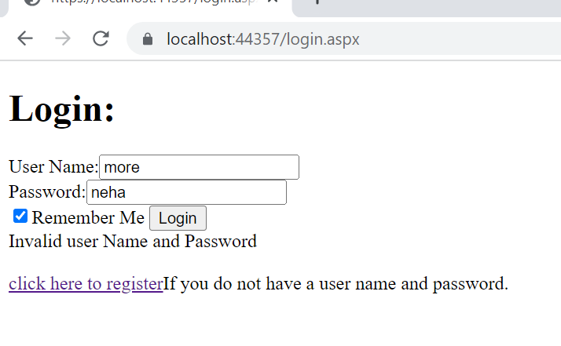
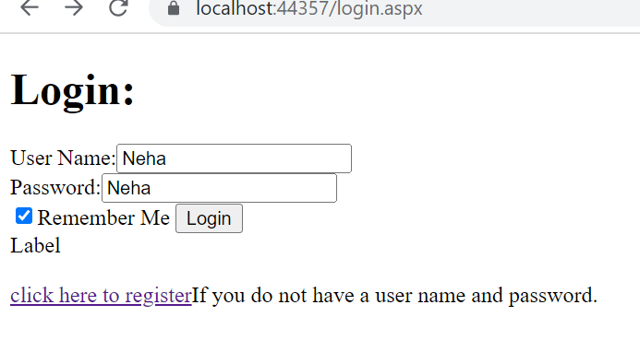
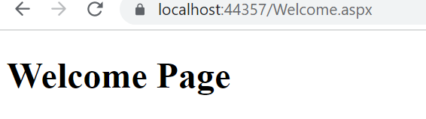
Login Unsuccessful
Login successful

Slide 11
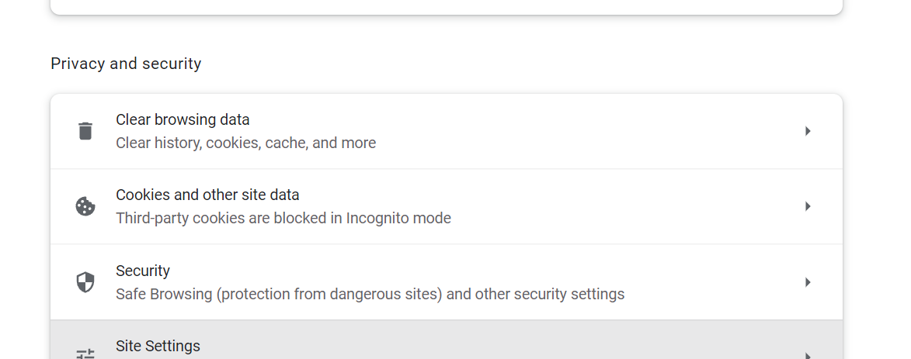
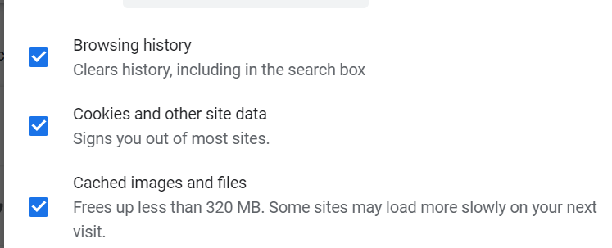
Deleting a Cookie—Delete Browser History--→first Method:
Second Method:
In Web.Config File make the following changes→
<forms loginUrl="login.aspx" defaultUrl="Welcome.aspx" timeout="20">

Slide 12
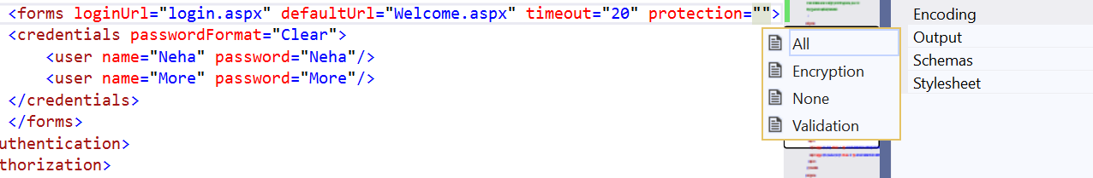
Protection Property:

